Slide 1
Normal Probability Distribution
The normal probability distribution is the most important distribution for describing a continuous random variable.
It is widely used in statistical inference.
It has been used in a wide variety of applications
including:
Heights of people
Rainfall amounts
Test scores
Scientific measurements
Abraham de Moivre, a French mathematician, published The Doctrine of Chances in 1733.
He derived the normal distribution.

Slide 2
Normal Probability Distribution
Normal Probability Density Function
where:
μ = mean
σ = standard deviation
π = 3.14159
e = 2.71828

Slide 3
Normal Probability Distribution
Characteristics
The distribution is symmetric; its skewness
measure is zero.
x

Slide 4
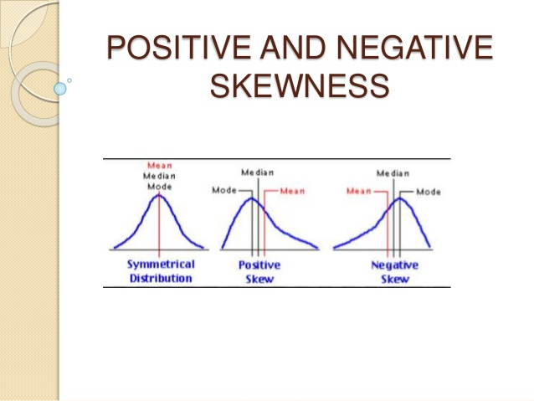

Slide 5
Normal Probability Distribution
Characteristics
The entire family of normal probability
distributions is defined by its mean μ and its
standard deviation σ .
Standard Deviation σ
x
Mean μ

Slide 6
Normal Probability Distribution
Characteristics
The highest point on the normal curve is at the
mean, which is also the median and mode.
x

Slide 7
Normal Probability Distribution
Characteristics
The mean can be any numerical value: negative,
zero, or positive.
x
-10
0
25

Slide 8
Normal Probability Distribution
Characteristics
The standard deviation determines the width of the
curve: larger values result in wider, flatter curves.
σ = 15
σ = 25
x

Slide 9
Normal Probability Distribution
Characteristics
Probabilities for the normal random variable are
given by areas under the curve. The total area
under the curve is 1 (.5 to the left of the mean and
.5 to the right).
.5
.5
x

Slide 10
Normal Probability Distribution
Characteristics (Area Property)
of values of a normal random variable
are within of its mean.
68.26%
± 1 standard deviation
of values of a normal random variable
are within of its mean.
95.44%
± 2 standard deviations
of values of a normal random variable
are within of its mean.
99.72%
± 3 standard deviations

Slide 11
Normal Probability Distribution
Characteristics (basis for the empirical rule)
99.72%
95.44%
68.26%
x
μ
μ – 3σ
μ – 1σ
μ + 1σ
μ + 3σ
μ – 2σ
μ + 2σ

Slide 12
Standard Normal Probability Distribution
A random variable having a normal distribution
with a mean of 0 and a standard deviation of 1 is
said to have a standard normal probability
distribution.
The letter z is used to designate the standard
normal random variable.
σ = 1
z
0

Slide 13
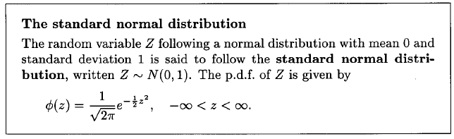
Standard Normal Probability Distribution
Converting to the Standard Normal Distribution

Slide 14
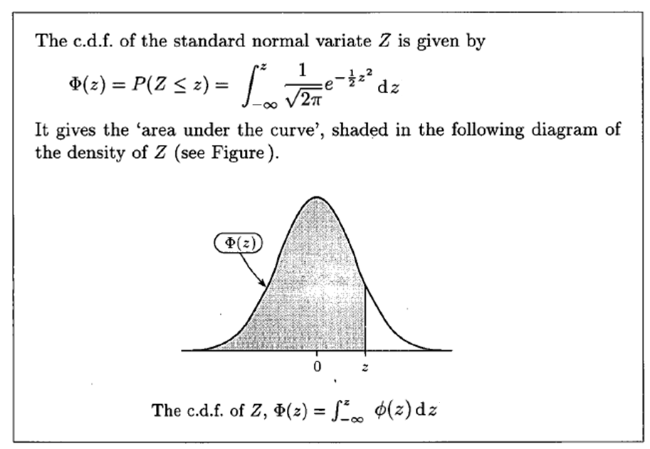

Slide 15
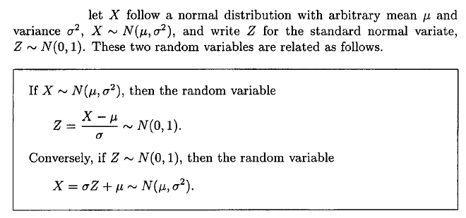
NORMAL DISTRIBUTION & STANDARD NORMAL DISTRIBUTION

Slide 16
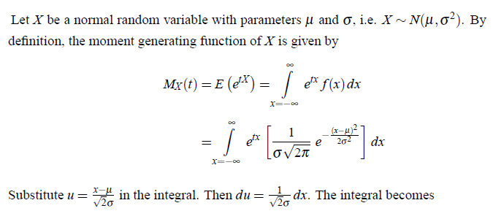

M.G.F , MEAN & VARIANCE OF NORMAL DISTRIBUTION

Slide 17
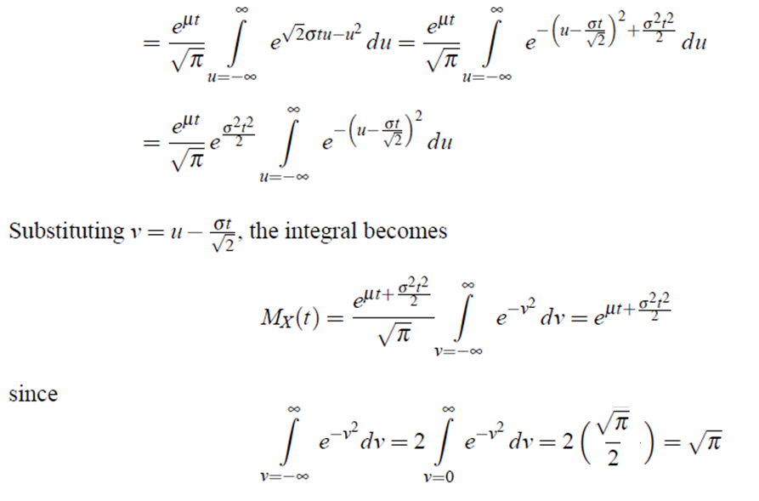


Slide 18

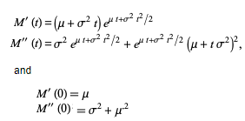
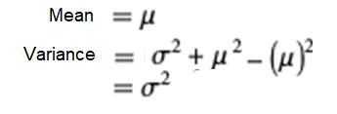

Slide 19
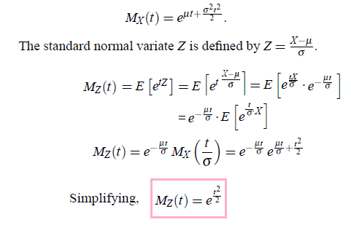
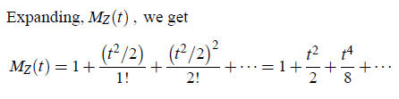
M.G.F , MEAN & VARIANCE OF STANDARD NORMAL DISTRIBUTION

Slide 20
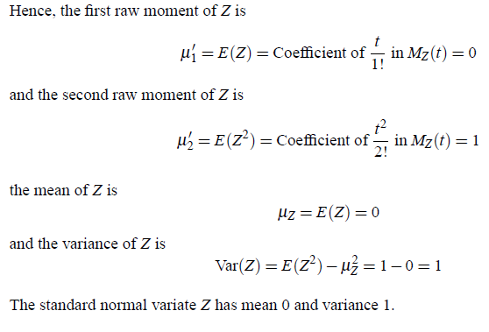

Slide 21
Standard Normal Probability Distribution
Cumulative Probability Table for
the Standard Normal Distribution
P(z < .83)
P(z < .83)

Slide 22
Standard Normal Probability Distribution
Compute the area under the standard normal
curve to the right of z = .83.
P(z > .83) = 1 – P(z < .83)
= 1- .7967
= .2033

Slide 23

